Slide 1
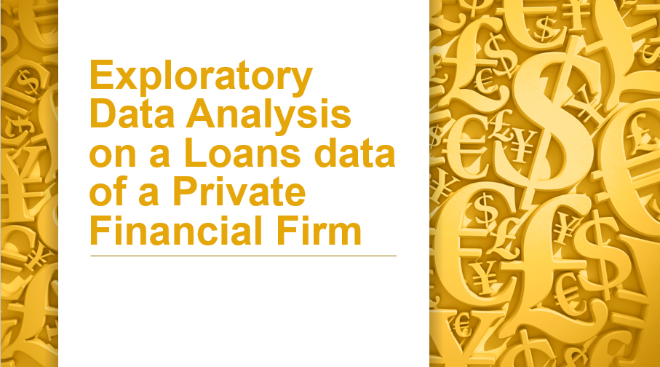

Slide 2
OBJECTIVE
Importing all the necessary modules.
Importing the data from an external source into the Python environment.
Renaming the variables as per the Naming conversion.
Performing necessary Datatype Conversions on the data.
Checking the relevant and irrelevant variables in the first phase of EDA.
Data Duplicacy: Chech if their is duplicate data or not: DDT ( Data Duplicacy Treatment)

Slide 3
Missing Values Treatment.
Separating the categorical Variables and Numerical variables into two different datasets for Data Preparations for Data Analysis.
Filling missing values in Numerical data with the Median values.
Filling missing values in Categorical data with the Mode values.
Visualizing relationship of variables using Matplotlib.pyplot
Outlier Treatment.

Slide 4
Importing all the necessary modules.
To importing necessary modules in python, we use “import” statement followed by the name of the module.
numpy : it is used for numerical computing. It provides support for large, multi-dimensional arrays and matrices. In numpy datastructure allows Broadcasting and Vectorization
Importing numpy: import numpy as np
pandas: it is a powerful library in python for data manipulation and analysis. It provides data structure like dataframe and series.
Importing pandas: import pandas as pd
Matplotlib.pyplot : which is used for creating static,interactive and visualization in python.

Slide 5
Matplotlib offers a wide range of plotting functions to create various types of plots such as Line plot, Scatter plot, Bar plot, Histogram and Pie chart.
Importing matplotlib: import matplotlib.pyplot as plt
Datetime: for the datetime data we import datetime.
Importing datetime : import datetime as dt
seaborn : it is a statistical data visualization module.
Seaborn simplifies the creation of complex visualization.
Box plot, Tree map, Heat maps are used to check correlations between multiple variables.
Importing seaborn : import seaborn as sns

Slide 6
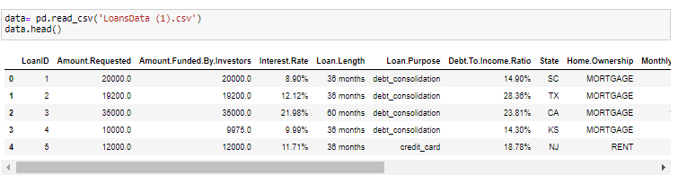
Importing the data from an external source into the Python environment.
To import data from an external source into a python environment, we use various methods depending on the type and format of the data.
In this project data is in the format of csv file. To read csv files using the read_csv() function.
Code:

Slide 7
Renaming the variables as per the Naming conversion.
According to the naming conversion :
Names should be starting with alphabets.
Do not use special characters except underscore.
There is no spacing between the names.

Slide 8

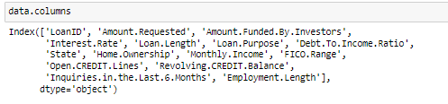
Checking the shape of the data.
Shape gives as the number of rows and columns of the data.
Checking the variable names and if it is not following the naming conversion then rename the variables.

Slide 9
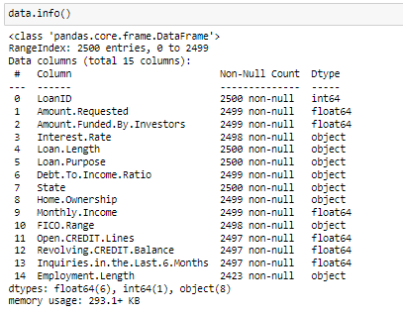
Getting the summary of the data frame , data.info() is used to get the concise summary of the Dara frame.
It provide information such as :
The total number of entries in each column.
The data type of each column.
The count of non-null values in each column.
The memory usage of the data frame.

Slide 10
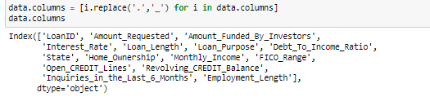
According to the naming conversion changing the special character “.” into “_”.
Code:

Slide 11
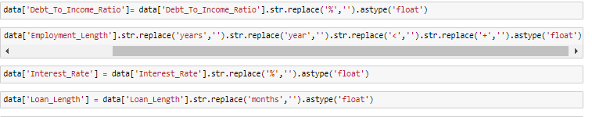
Performing necessary Datatype Conversions on the data.
Datatype conversion is convert one data type to another type.

Slide 12
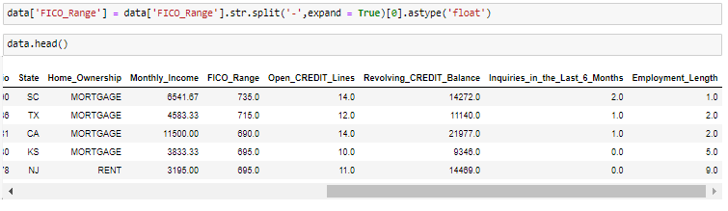

Slide 13
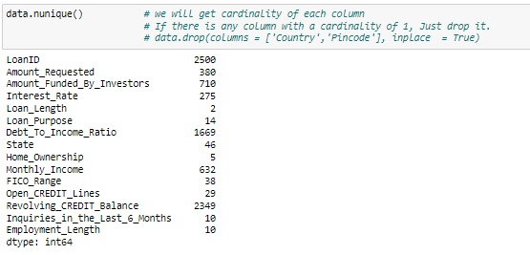
Checking the relevant and irrelevant variables in the first phase of EDA.
In the first phase of Exploratory Data Analysis (EDA), determining relevant and irrelevant variables is crucial for understanding the dataset and shaping further analysis.

Slide 14
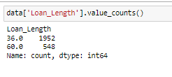
Data.nunique() is used to count the number of unique values in a data frame or series.
Value _counts() is used to count the occurrences of unique values .

Slide 15
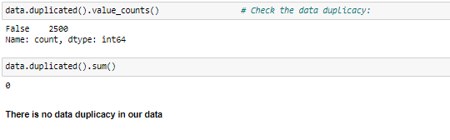
Data Duplicacy: Chech if their is duplicate data or not: DDT ( Data Duplicacy Treatment)
In python we can treat data duplicacy using pandas.

Slide 16
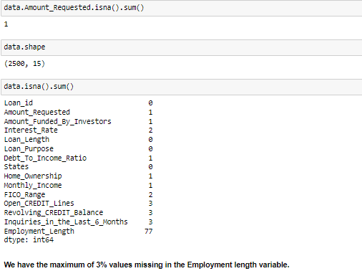
Missing Values Treatment.
Detecting the missing value in each column:
Code: data.isna().sum()
or
Data.isnull().sum()

Slide 17
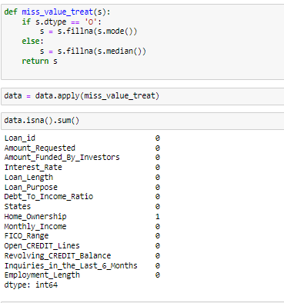
Creating a UDF which can automate the missing value treatment.

Slide 18
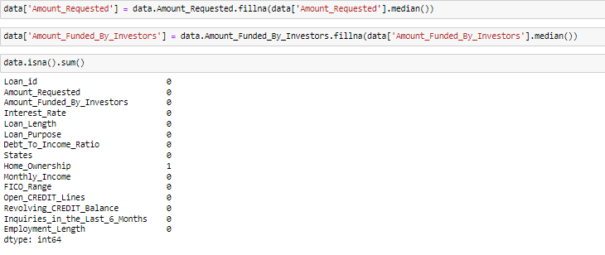
Fill the missing values with the mean or median.

Slide 19

Separating the categorical Variables and Numerical variables into two different datasets for Data Preparations for Data Analysis.
Separating the categorical Variables and Numerical variables can streamline data preparation and analysis workflows, making it easier to work with heterogeneous datasets.

Slide 20
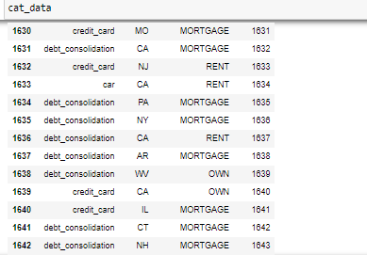
Categorical data of loan data.

Slide 21
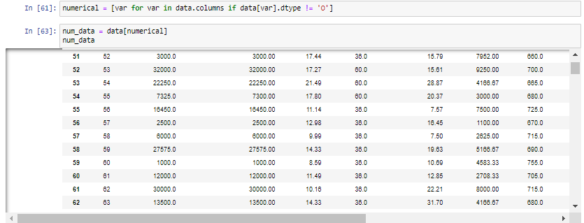
Numerical data of loan data.

Slide 22
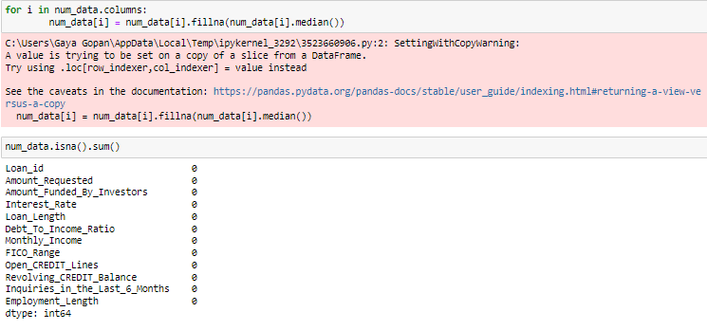
Filling missing values in Numerical data with the Median values.

Slide 23
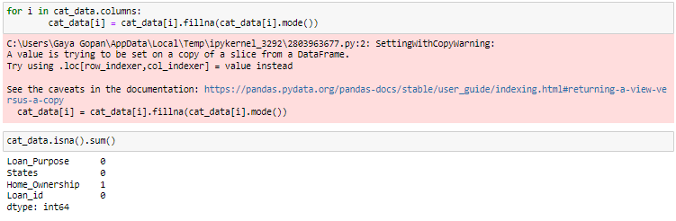
Filling missing values in Categorical data with the Mode values.

Slide 24
Visualizing relationship of variables using Matplotlib.pyplot.
Matplotlib.pyplot : which is used for creating static,interactive and visualization in python.
Matplotlib offers a wide range of plotting functions to create various types of plots such as Line plot, Scatter plot, Bar plot, Histogram and Pie chart.
Line plot: Line plot display data points connected by straight line segment. It commonly used to visualize the relationship or trends.
Scatter plot: Scatter plot is used to show the correlation between two numerical variables.
Bar plot: Bar plot is used for comparison analysis. It shows the relation between one numerical variable and one categorical variable.
Histogram: Histograms are very helpful to see the frequency distribution by only numerical variable.
Pie chart: used for showing the percentage distribution of a numerical variable by one categorical variable.

Slide 25
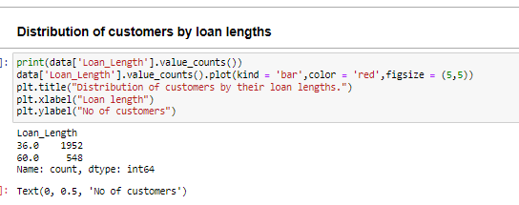
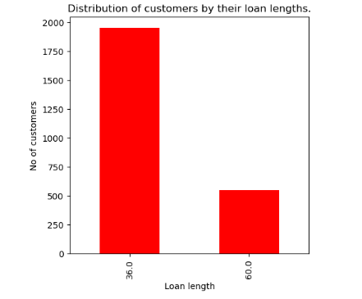


Slide 26
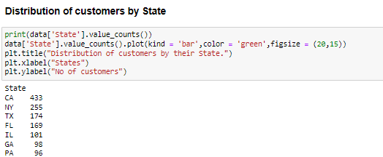
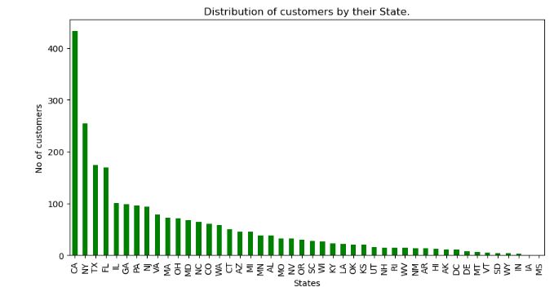

Slide 27
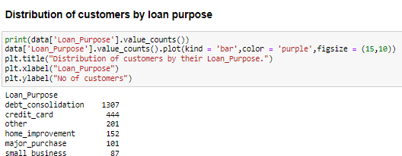
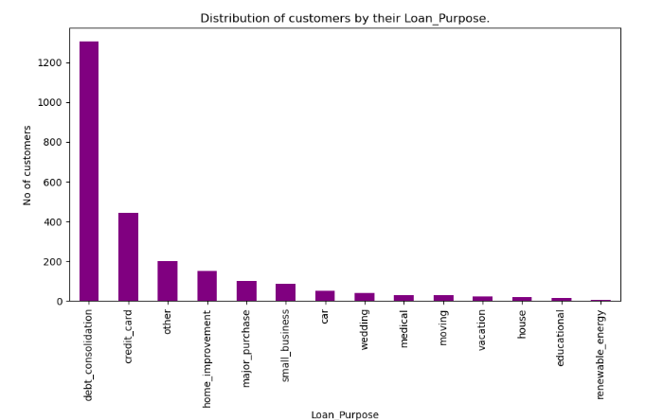

Slide 28
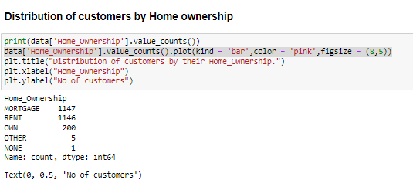
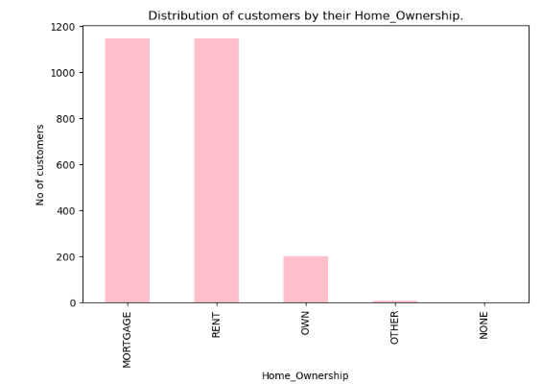
1147 customers are mortgage loans to owner the home and rent home ownership is 1146. Most of the customers are having these two ownerships

Slide 29
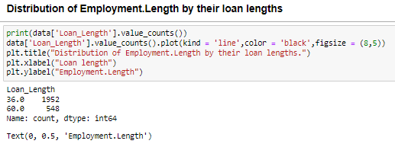
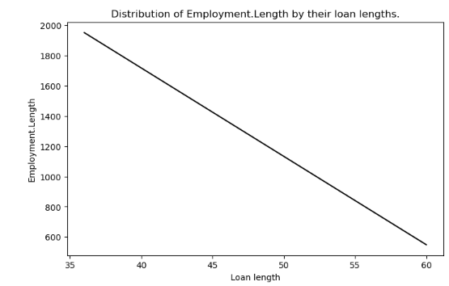
Here the Employment Length increase then the loan length decreases

Slide 30
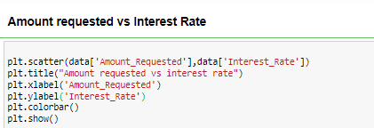
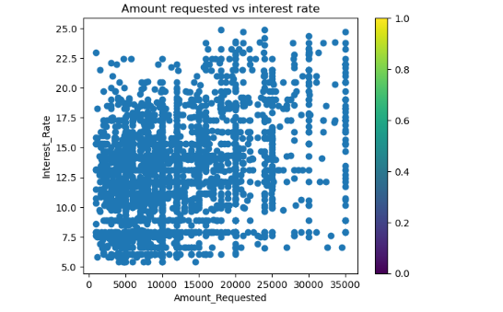
Most of the customers requested amount upto 15000 and mostly fetches the interest rate between 7.5 and 17.5

Slide 31

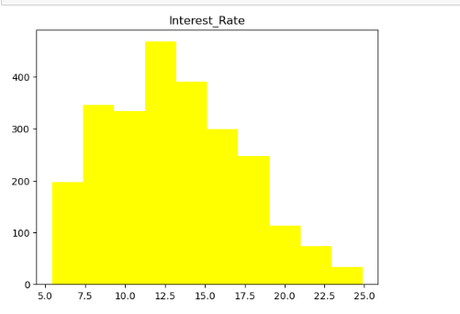

Slide 32

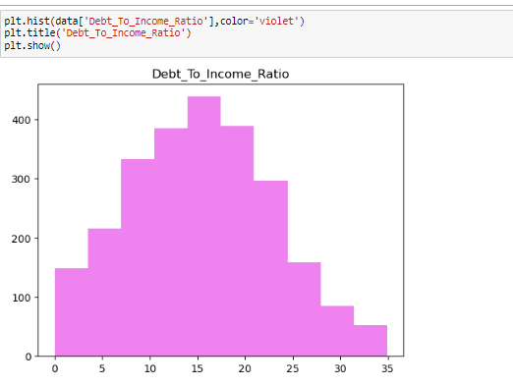

Slide 33
Outlier Treatment.
In python outlier is a data point that significantly differ from other observations in a dataset.
Outlier is a value either very large or either very small.
To perform outlier treatment using the interquartile range (IQR) method .
Mean of the data gets affected by the outlier and median not affected much.

Slide 34
CONCLUSION
In conclusion, our exploratory data analysis of the loan dataset has provided valuable insights into key trends and patterns. By examining variables such as loan amounts, open credit Lines, employment lengths we've gained a better understanding of the factors influencing loan approvals and defaults. Our findings highlight the importance of data-driven decision-making in optimizing lending strategies and mitigating risks. Moving forward, these insights can guide targeted marketing efforts, refine credit risk assessment models, and ultimately improve overall business outcomes.

